Slide 1
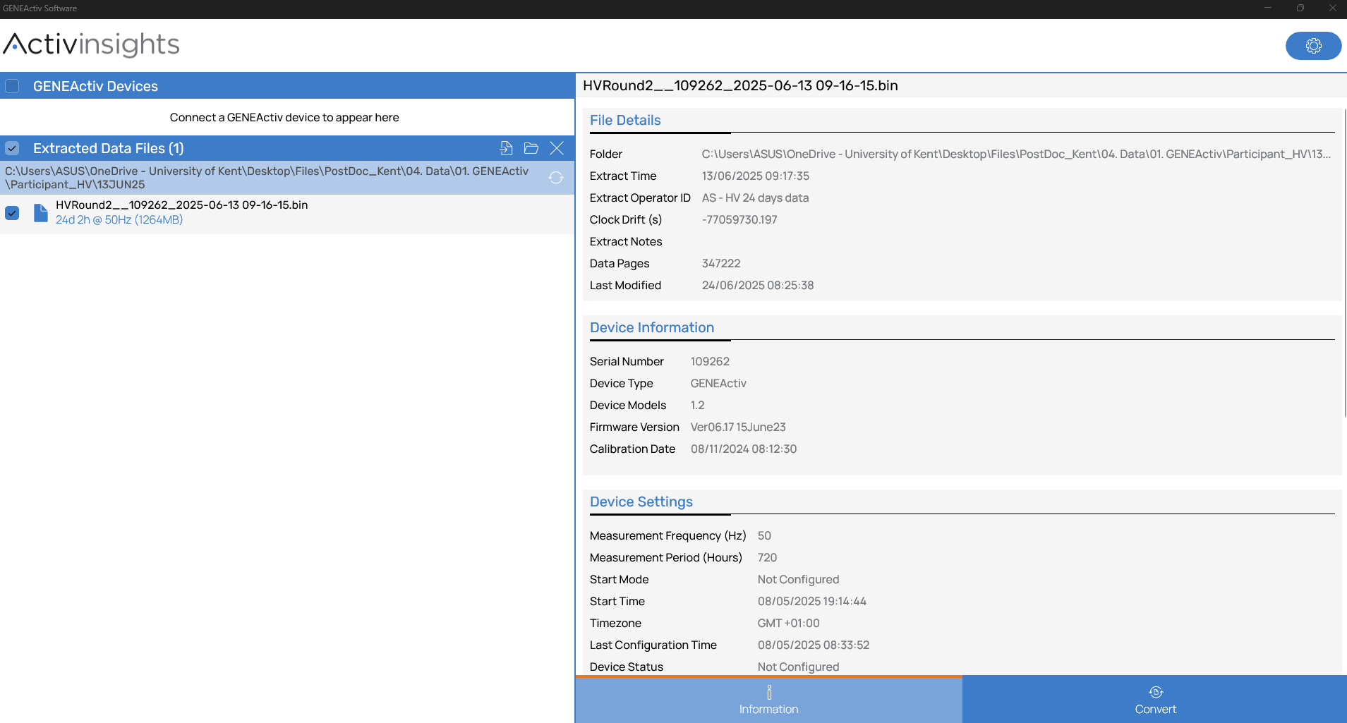
1. Select extracted data from the GENEActiv software

Slide 2
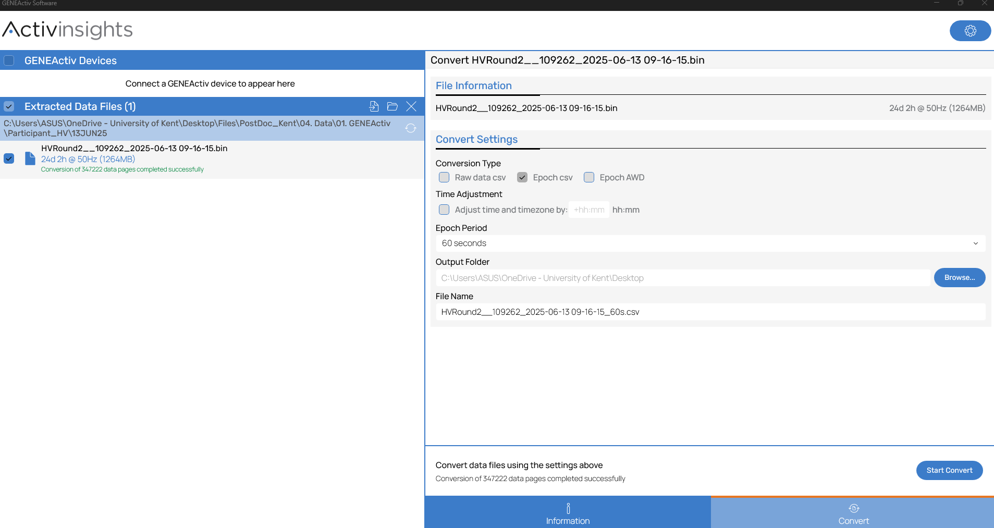
2. Go to the “Convert” tab
3. Check it’s the correct file
4. Select “Epoch csv” and your desired Epoch period and ensure it’s the correct “Output folder” and “File Name”

Slide 3
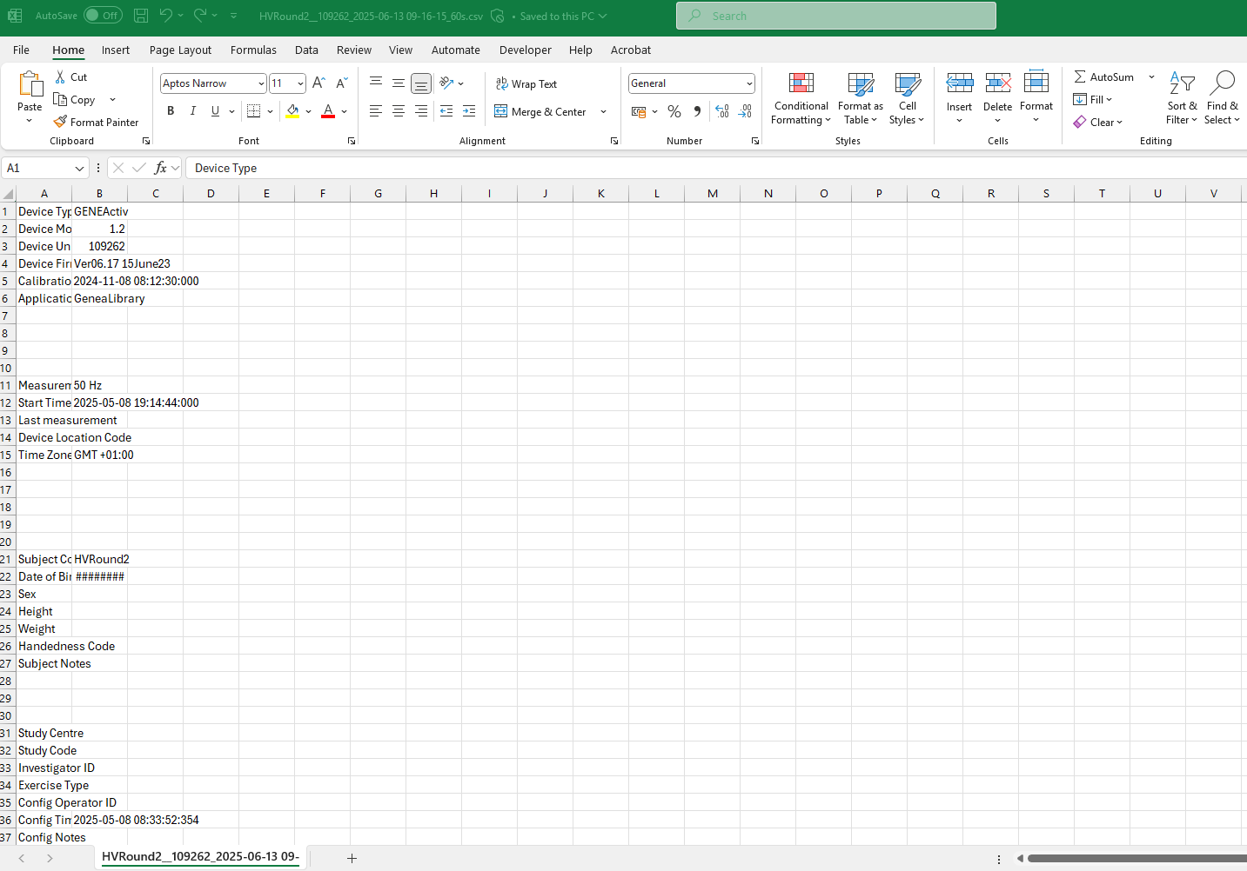
5. Open the csv file and scroll down to the raw data

Slide 4
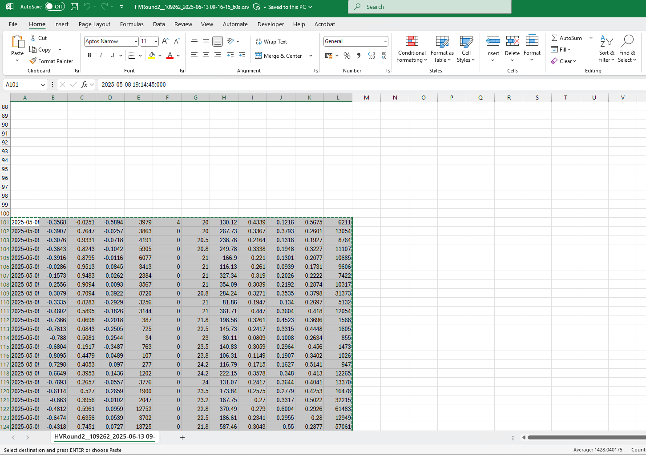
6. Copy the raw data

Slide 5
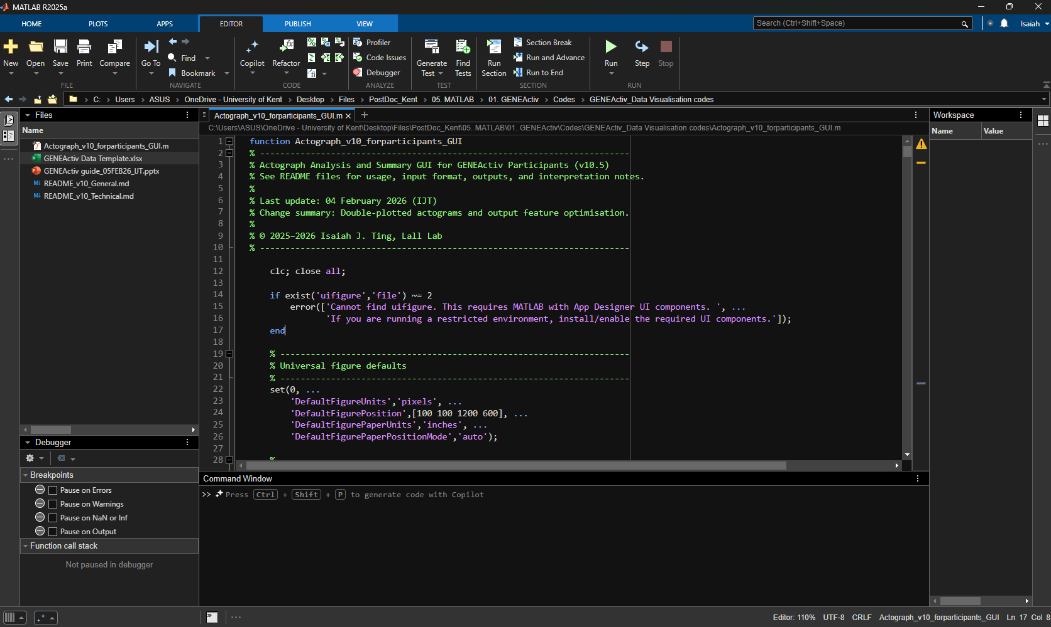
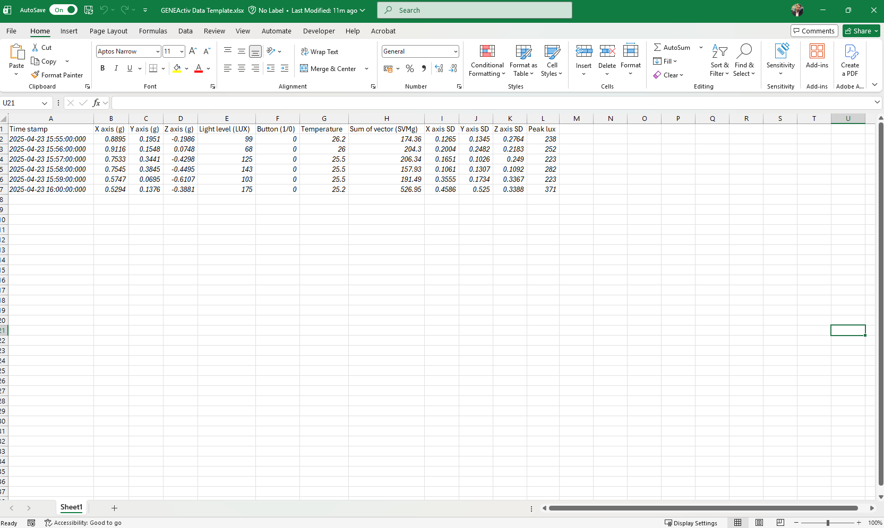
7. In the “GENEActiv_Data Visualisation codes”, open the “GENEActiv Data Template.xlsx
Note: currently the data template file has some italicised data to provide an example of expected data format, please delete and replace with actual raw data.

Slide 6
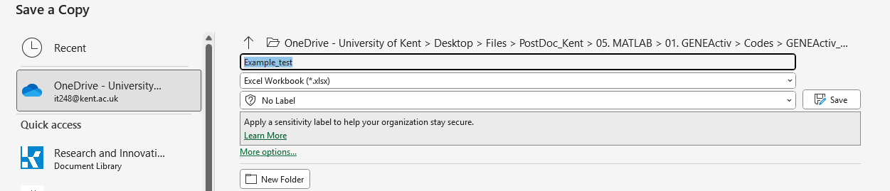
8. Ensure to save a local copy before pasting any raw data
Note: ensure that the data format is “.xlsx”, this can be modified in the second drop down menu.

Slide 7
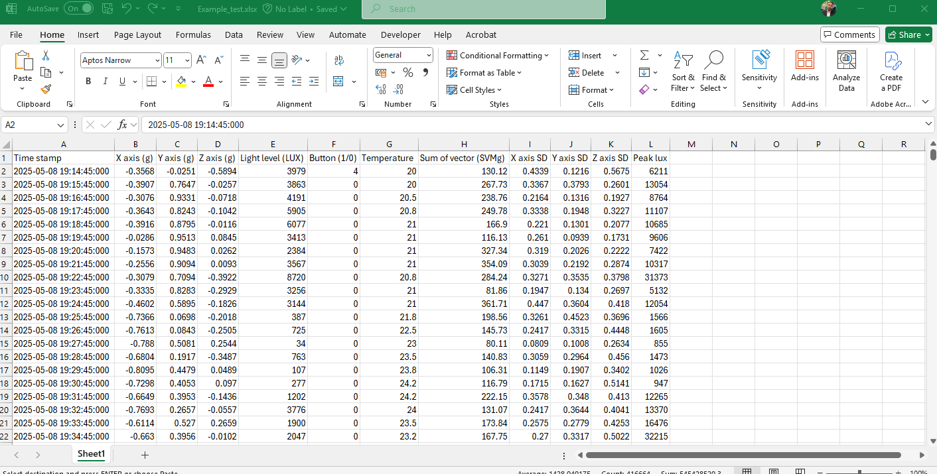
9. Paste the raw data to your saved file

Slide 8
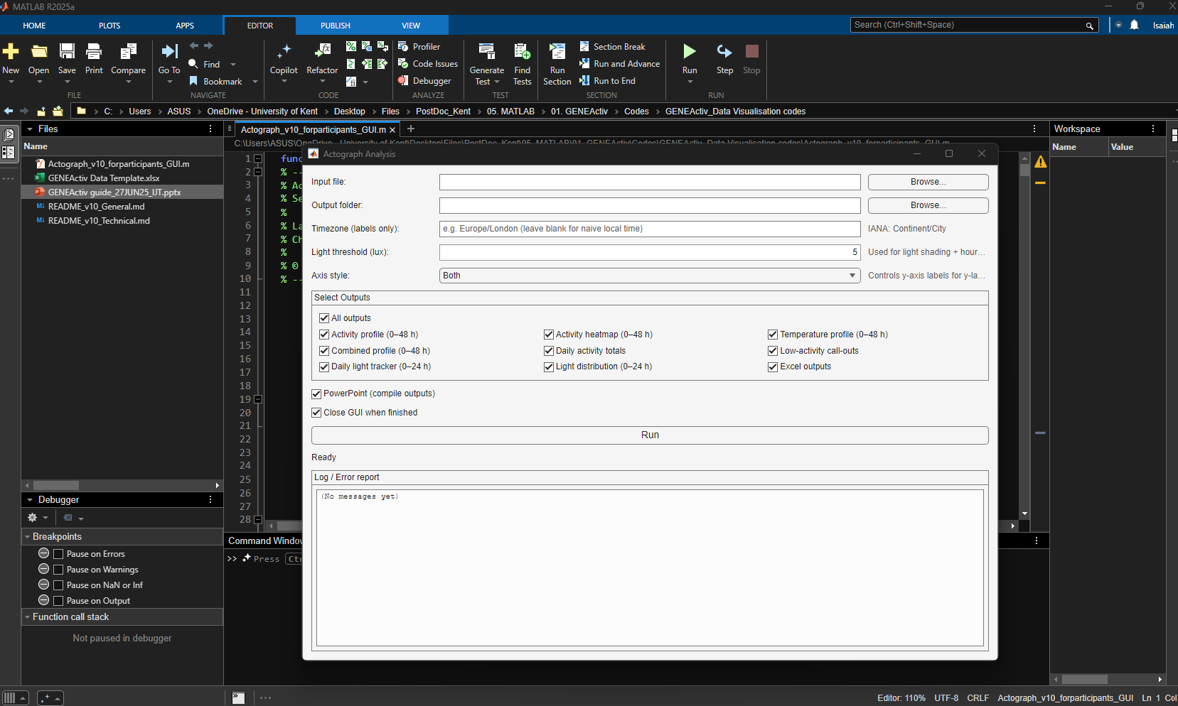
10. Click “Run”
11. Select your input file
12. Select the desired output folder
13. Select time zone using “[Continent]/[City]” format, if desired
14. Adjust light threshold
15. Select axis styles, either just in “Days” or “Dated”, or both
16. Select the outputs desired
17. Select the outputs desired
Note: it is recommended to untick “Close GUI when finished” to view potential errors and any information relevant at the end of the analysis in the “Log/Error report” box

